Slide 1
17302测试结果

Slide 2
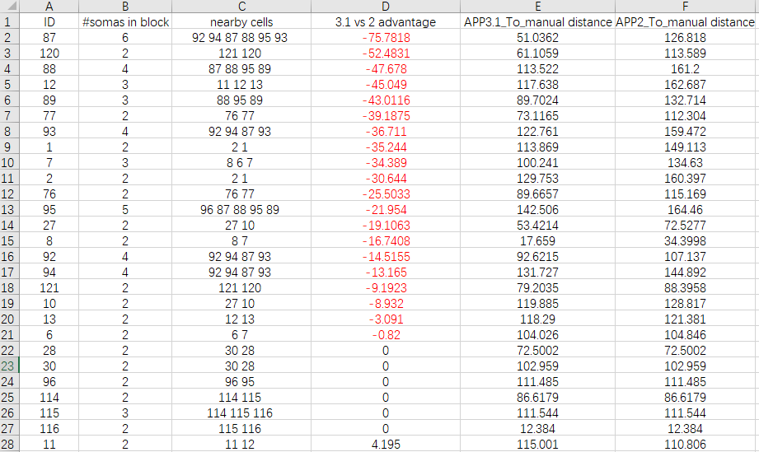
Overall results: -APP3.1 vs. APP2 auto tracing in 512³ volume

Slide 3
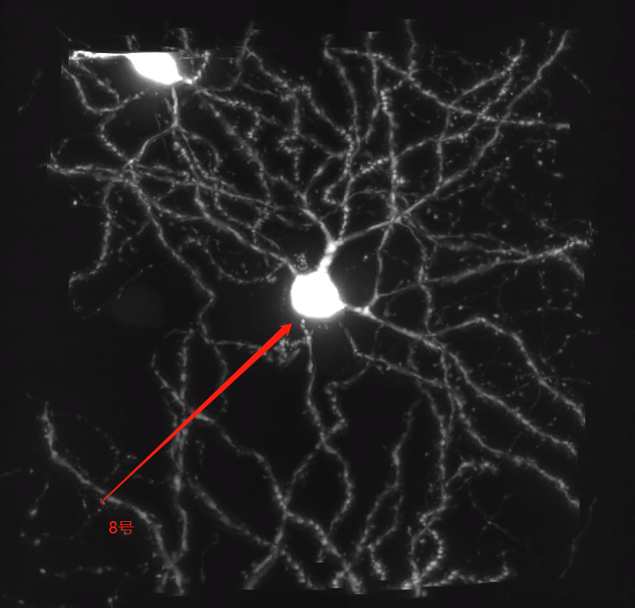
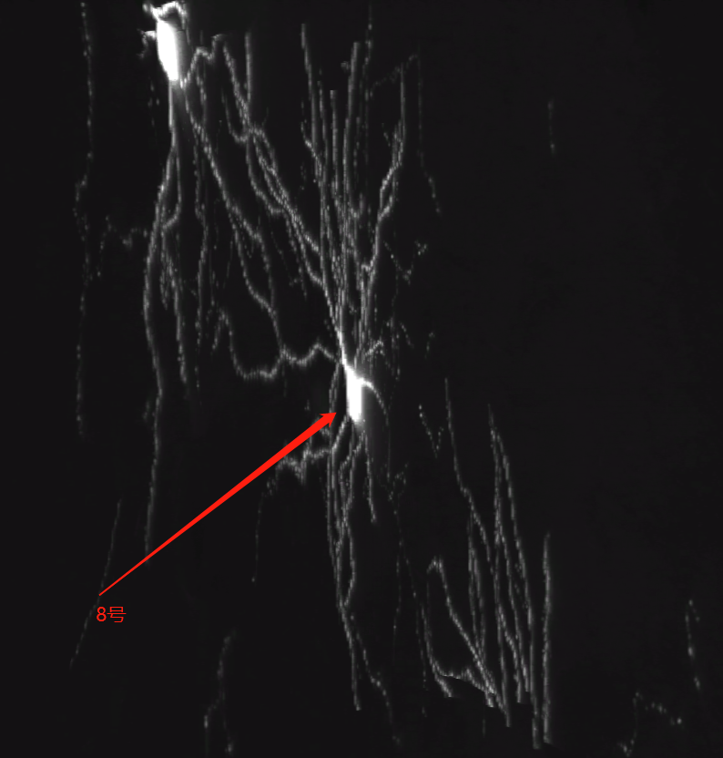
[Result 1]: ID(8) Nearby cells: 7

Slide 4
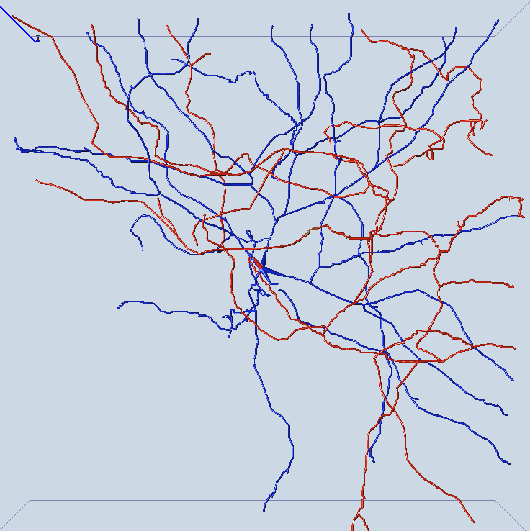
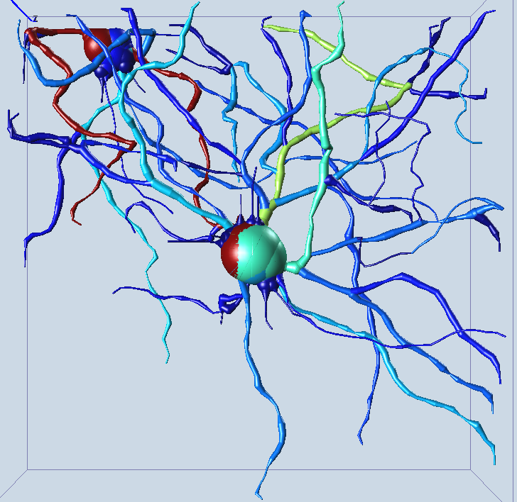
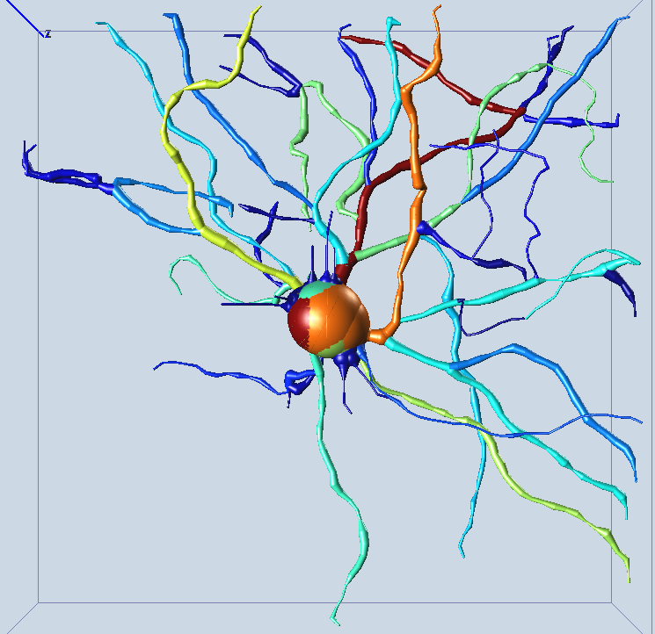
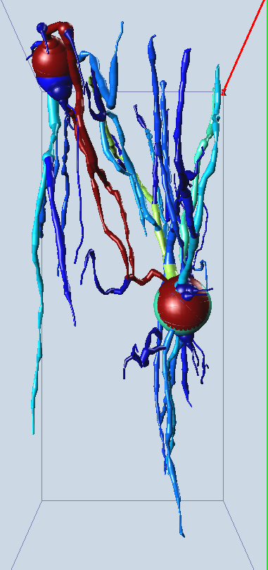
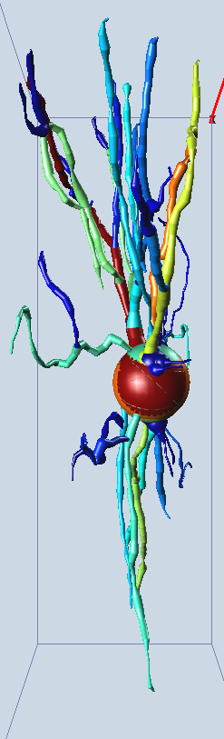
manual APP2 APP3.1

Slide 5
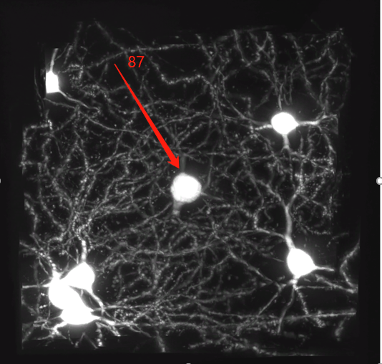
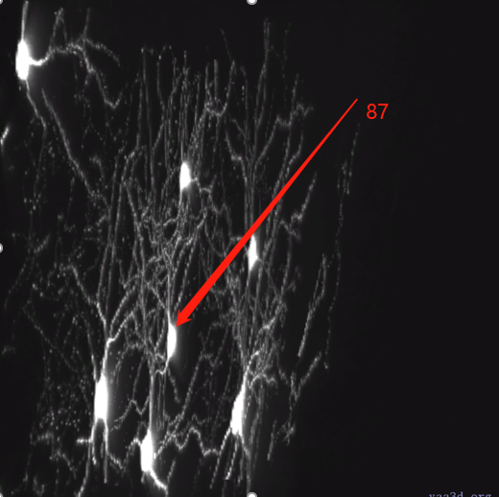
[Result 2]: ID(87) Nearby cells:88 92 93 94 95

Slide 6
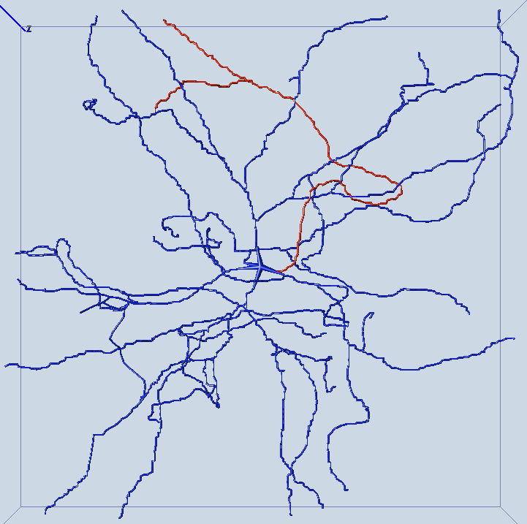
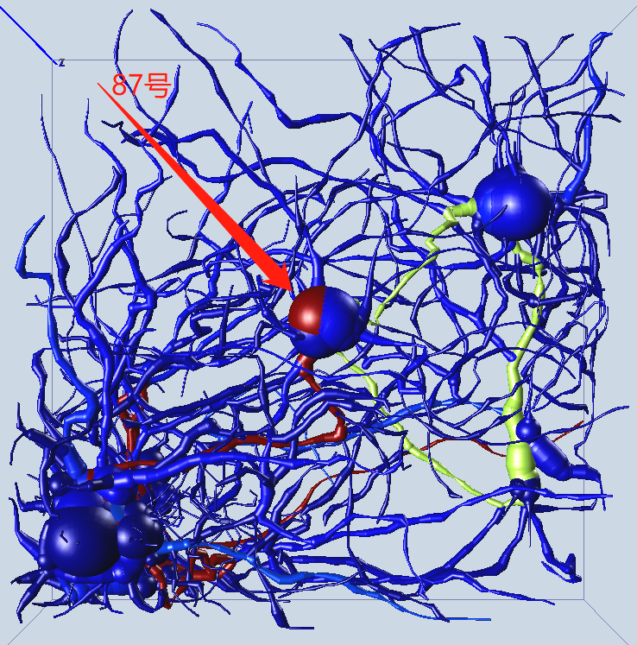
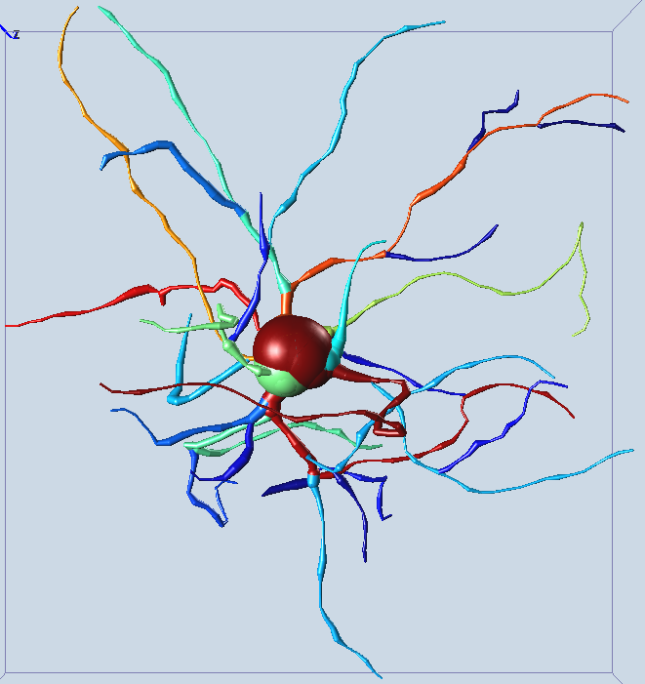
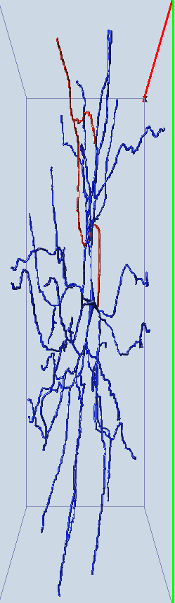
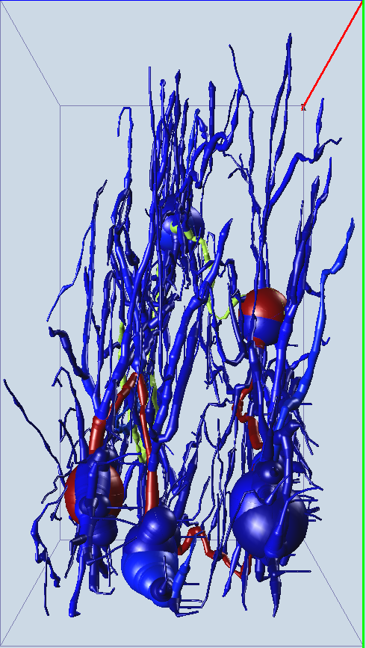
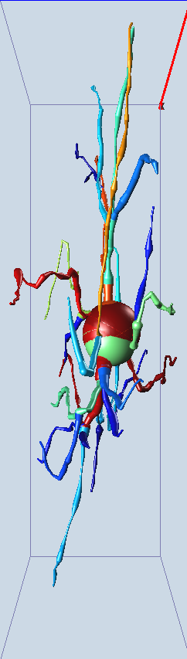
manual APP2 APP3.1

Slide 7
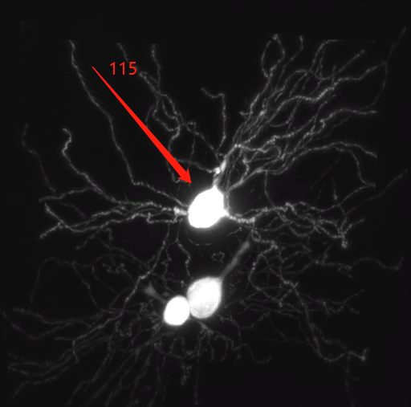
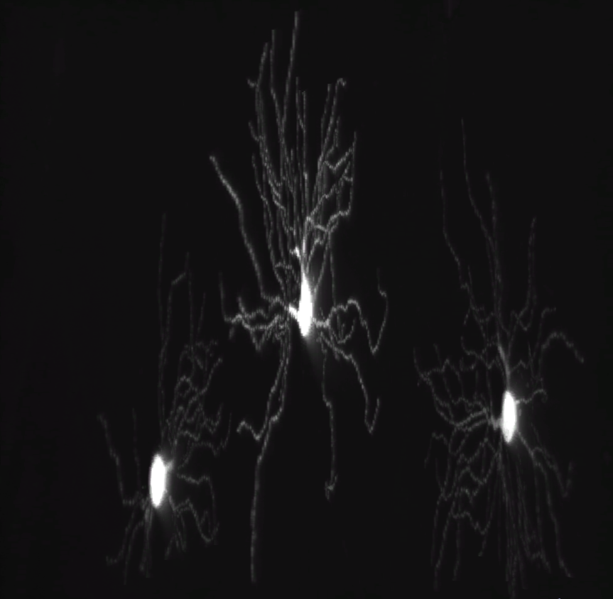
[Result 3]: ID(115): where results of APP3.1 = APP2
虽然同一个block有多个soma，但是没有相互影响因此：
App2==App3.1
注：
类似情况还有以下编号神经元
28 30 96 114 116

Slide 8
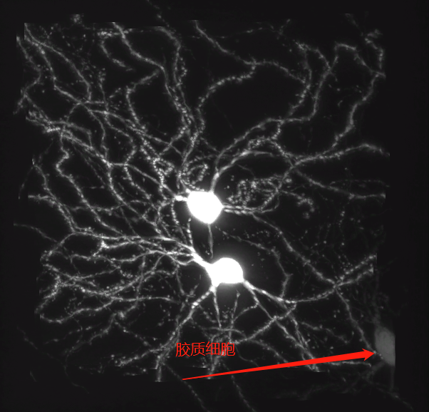
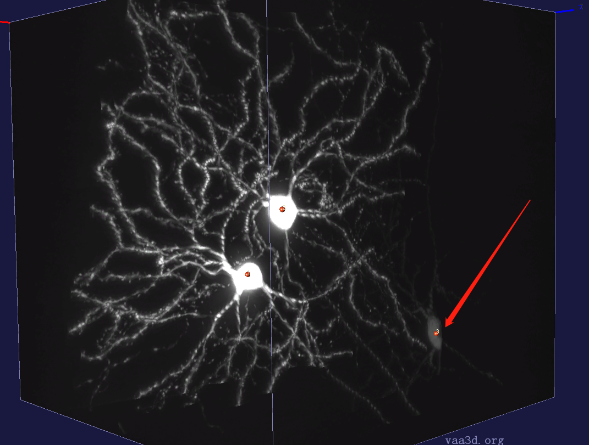
[Result 4]: ID(1): containing glia cell

Slide 9
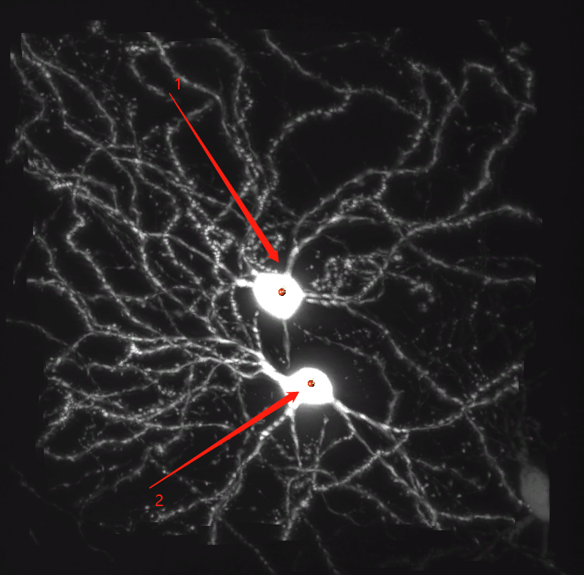
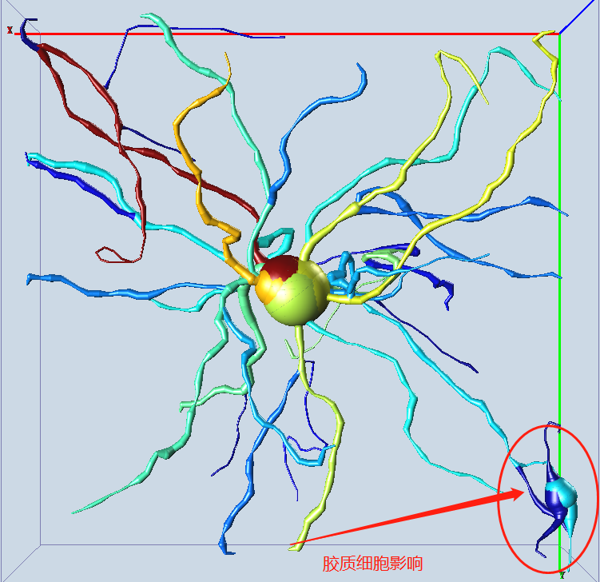
Give two markers using app3.1

Slide 10
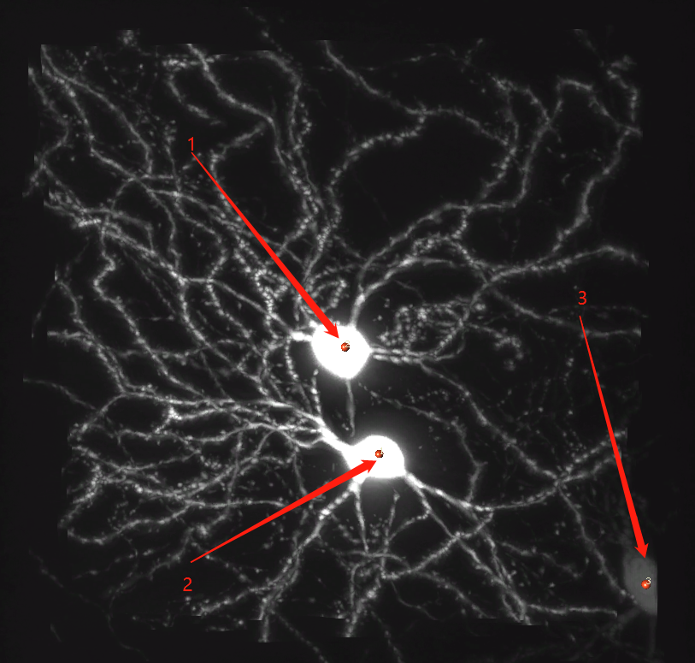
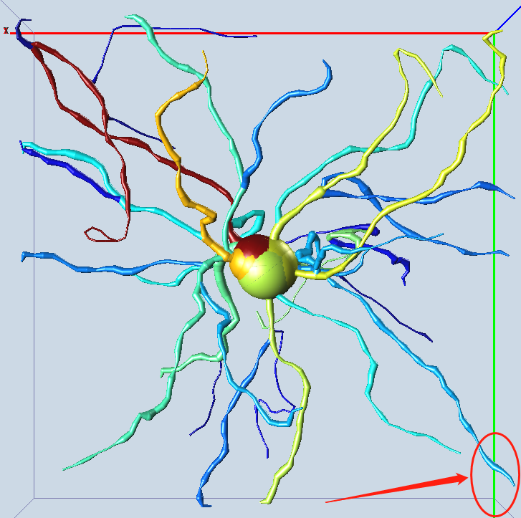
Give three markers using app3.1

Slide 11
Discussions
通过诸多类似ID(1)的结果，我们发现可以简化soma检测的程序
即：不需要详细区分soma和glia，归为一类即可
Multiple Soma Auto-tracing Frame ，标记glia当作soma点，会提升程序的可靠性

Slide 12
Conclusion
App3.1 can improve the tracing result when there are multiple somas in the volume
App3.1 can also handle single soma cases, just as APP2
In summary, app3.1 is not worse than app2
We can use the Multiple Soma Auto-tracing Frame to any algorithms such as: APP1, Monte-Carlo and so on.

